Slide 1
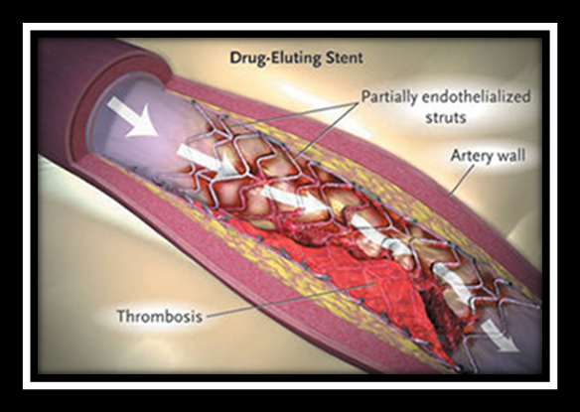
Stent thrombosis
Dr Rakesh Jain
Senior Resident, Dept. of Cardiology,
Govt. Medical College, Calicut
September 22nd, 2014

Slide 2
St: Definition (Academic Research Consortium)
Definite ST:
Clinical syndrome (ACS or AMI) and
Angiographic evidence of thrombus or occlusion, or
Pathologic evidence of acute thrombosis
Probable ST:
Unexplained death < 30 days or target vessel AMI without angiographic confirmation of thrombosis
Possible ST:
Any unexplained death after 30 days
Cutlip DE et al, Circulation 2007; 115: 2344-2351

Slide 3
Timing of stent thrombosis

Slide 4
Incidence of st
Cumulative incidence: 0.5% - 1% at 1st year
In a meta-analysis of RCT’s, ST at 1 yr is similar for DES & BMS, but beyond 1 year, it is greater with DES
Highest with 1st generation DES (˃BMS, 2nd & 3rd generation stents)
Course of DES ST is markedly protracted compared to BMS
Late stent thrombosis is very rarely seen with BMS
Kirtane AJ et al. Circulation 2009;119:3198–206
Bavry et al. Am J Med. 2006 Dec;119(12):1056-61

Slide 5
St: bms v/s des
28 RCT’s involving 10,727 patients
Treated with 2nd generation DES v/s BMS
Showed no differences in mortality at 1 yr [RR: 0.91, p= 0.47] or beyond [RR: 1.03, p= 0.79]
Definite increase in ST was observed beyond 1 yr in 0.7% in DES treated v/s 0.1% in BMS treated pts [RR: 4.47, p= 0.006]
These findings was similar to other analysis involving 22 RCT’s (n= 9470) and 34 observational studies (n= 182,901)
Kirtane AJ et al. Circulation 2009;119:3198–206

Slide 6
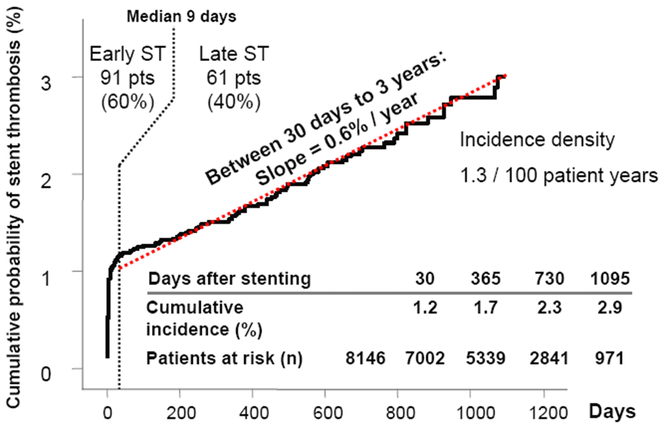
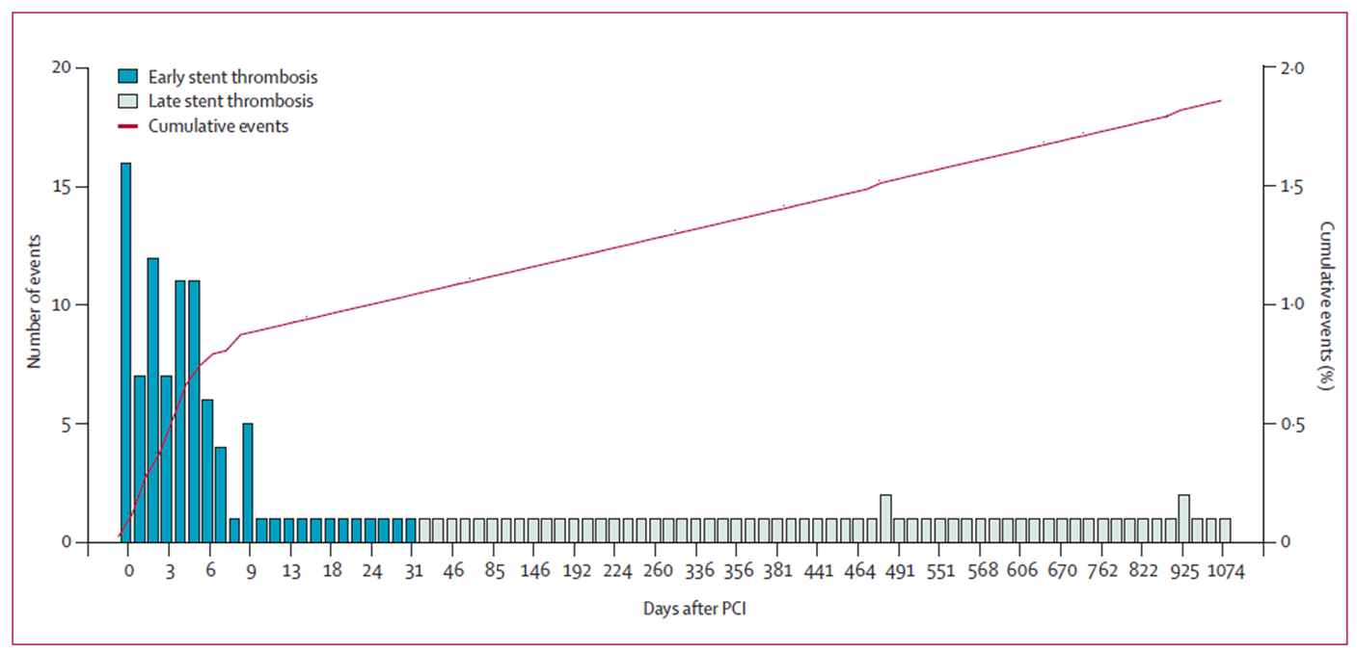
Real-world DES thrombosis Rotterdam/Bern Registry
8,146 pts, 1st generation DES (SES or PES), 2002 - 2005
Angiographically proven ST
90% of all DES patients complete clinical follow-up
Cumulative incidence of ST: 1.7% at 1st yr→0.6%/yr
60% early: 40% late ST
Wenabeser et al JACC 2008;52:1134-1140

Slide 7
Class effect analysis in des
ST is higher in PES than in SES, In contrast, SIRTAX trial (n=1,012, lesion treated:1,401): 5 yr follow up showed insignificant diff b/t PES v/s SES (4.1% v/s 4.6%, p= 0.74)
SPIRIT IV Trial: Large-scale, prospective, multicenter, randomized,(n=3,687) Xience V everolimus DES with Taxus PES found significantly less definite/probable ST in Xience V stent at 1 yr (0.3% v/s 1.1%; p=0.003) sustained at 2 yrs
COMPARE Trial: RCT, n-1,800, Everolimus v/s Taxus PES found significantly less definite/probable ST in Xience V stent at 1 yr (0.7% v/s 2.6%; p=0.002) despite similar DAPT
Endeavor IV trial: RCT, n=1,440; found relatively lower rate of very late(˃1 yr) ST with Endeavor zotarolimus stent v/s Taxus PES (0.1% v/s 1.5%: p=0.004)
Overall there is no adequately powered RCT’s for definite conclusion regarding relative risk of ST among DES
Stellar C et al. Lancet 2007;370:937– 48
Stone GW et al 23, 2009; San Francisco, CA
Smits P et al. J Am Coll Cardiol Intv 2010;3:76 –7.
Leon M et al. 2009; San Francisco, CA.

Slide 8
Timing and incidence of stent thrombosis
Incidence of early ST is similar in BMS & DES (PES˃SES) , very late ST is significantly higher in DES

Slide 9
predictors of stent thrombosis
PATIENT FACTORS
LESION FACTORS
PROCEDURAL & MEDICAL RX FACTORS

Slide 11
Individual contribution for st

Slide 12
Genetic variability in risk of stent thrombosis
Approximately 1/4th of pts undergoing stenting may be resistant
to clopidogrel, usually related to cyt P450 liver enzymes
Risk of ST is highest in cyt P450 homozygous (2-14% population)
CYP2C19*2 genotype accounts for only 12% clopid resistance,
which can be overcome by increasing the dose or switching to
prasugrel (not influenced by genetic polymorphism) or triple
antiplatelet regimen including aspirin, clopidogrel and cilostazole
Gauri AM Eet al. J Am Coll Cardiol 2008;52:734 –9.
Mega et al, New Engl J Med 2009
Jeong Yhet al J Am Coll Cardiol 2009;53:1101–9.

Slide 13
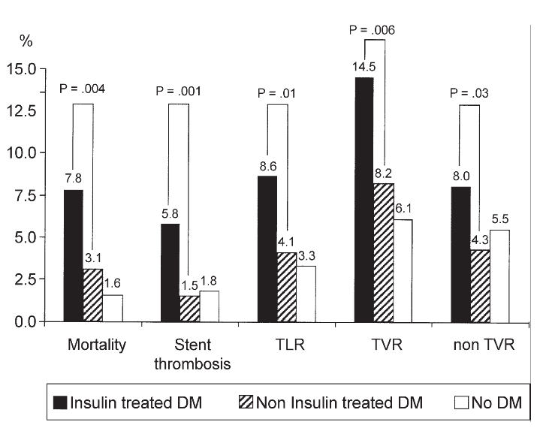
Predicting thrombosis according to diabetes “EVASTENT Registry” multicenter cohort registry of 1,731 patients
Machecourt et al. EVASTENT registry. J Am Coll Cardiol 2009

Slide 14
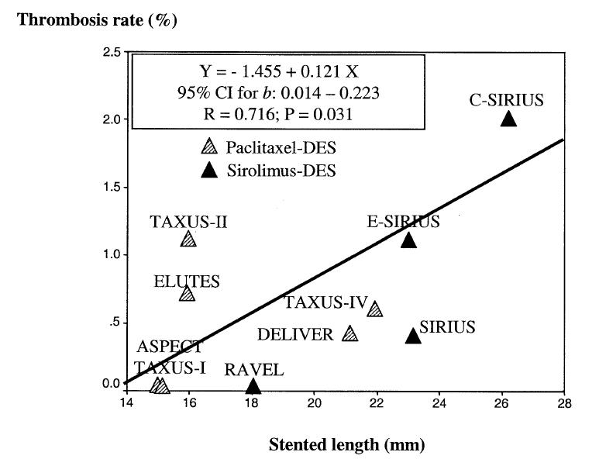
Predicting thrombosis according to stent length

Slide 15
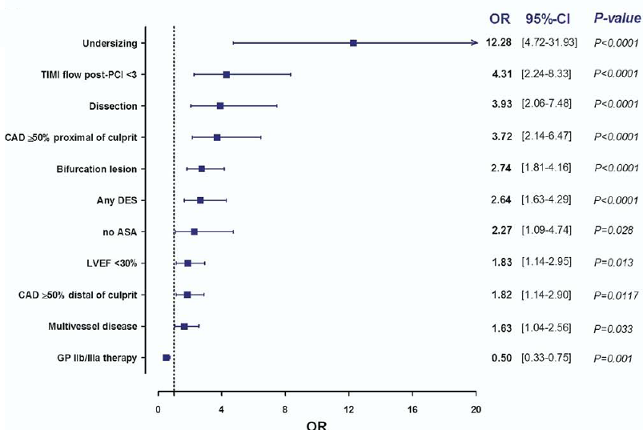
Predictors of stent thrombosis after ACS
Van Werkum et al, J Am Coll Cardiol 2009

Slide 16
Mechanisms of early ST
Mainly procedure related
Residual dissection (MC)
Stent under expansion or malapposition
Persistent thrombus
Tissue prolapse
Slow flow
LV dysfunction

Slide 17
Mechanisms of late ST
Primary mechanism: incomplete endothelialisation of intima over stented segment
Other causes:
DES: Non absorbable polymer
Long stents
Long overlapping zone
Bulky stent strut
Bifurcation stenting (due to multiple layers of struts)
Stent crossing side branch
BMS: Major mechanism: intracoronary irradiation (in past)

Slide 19
Mechanisms of increased Early ST after acs An Ex -Vivo Human Autopsy Study
Several fold increase risk of ST regardless of stent type compared with stable CAD
In a registry, ST is more in DES than in BMS in between 6 -12months after implantation
Factors involved are:
Necrotic core prolapse
Maximal underlying thrombus thickness
Lipid rich unstable plaque with abundant inflammatory cells
Medial tear
Incomplete apposition
All leads to incomplete healing & reduced neointimal coverage compared with strut imbedded in adjacent fibro-calcific stable plaque.
Park DW et al J Am Coll Cardiol Intv 2008;1:494–503
Masataka Nakano et al. JACC: Vol. 63, No. 23, 2014

Slide 20
Masataka Nakano et al. JACC: Vol. 63, No. 23, 2014

Slide 21
Outcome of st
Catastrophic outcome
MI d/t ST is associated with larger thrombus burden, more frequent distal embolization and less successful catheter based PCI reperfusion
e-Cypher registry (n=15,566: in 2004) reported 42% mortality incidence and 44% incidence of MI due to SAT after SES implantation while Iakovou et al reported a 45% mortality following ST
Overall:
Mortality 20-40% at 30 days
STEMI 60-70%
Post ST patients are remained at increased rate of recurrent ST, recurrent MI and death up to 3 years
Iakovou I et al. JAMA 2005;293:2126 –30
Kurtane AJ et al. Circulation 2009;119: 3198–206
van Werkum JW et al Circulation 2009;119:828 –34

Slide 23
Prevention of st
No method completely prevent ST, however it can be minimize with certain precautions
Two factors:
Advanced stent technologies
DAPT and patient compliance

Slide 24
Effect of new stent technology
AIMS:
To improve the intraoperative technical ease (improving flexibility, tractability, deliverability)
To decrease the incidence of ST
To decrease the incidence of ISR
To reduce the duration of DAPT

Slide 25
2nd & 3rd generation stents
1. Strut design: One of the major difference b/t 1st and 2nd or 3rd generation stents
1st generation: 316L stainless steel scaffold, strut thickness ≈100-150 µm
2nd or 3rd generation stents: Cobalt-Chromium or Platinum-Chromium struts (≈ 75µm)
Hence having similar radial strength with thinner strut
Resulting in decreased ST by:
Facilitating endothelialisation
Decreased thrombogenicity

Slide 26
2. Newer polymers: in 2nd generation stents
Phosphoryl choline in ZES & fluoropolymer in EES (relatively inert material)
Results in decreases incidence of ST by
Less inhibition of endothelialisation
Reduced inflammation
Thromboresistant properties of polymer

Slide 28
ST With 2nd Versus 1st Generation DES in Real-World PCI: Analysis of 3,806 Consecutive Procedures From a Large Volume Single Center Prospective Registry
Incidence of ST is almost 2.4 times higher in 1st generation stents
*ESTROFA-2 registry showed similar results
Helder Dores et al. J INVASIVE CARDIOL 2013;25(7):330-336
Jose M et al. J Am Coll Cardiol Intv 2010;3:911–9

Slide 29
Significantly higher rate of very late ST in DES compared with BMS
Lowest rate of ST with CoCr-EES compared with other DES & BMS
Tullio Palmerini et al. J Am Coll Cardiol 2013;62:1915–21

Slide 30
SCAAR (Swedish Coronary Angiography and Angioplasty Registry) in acs
AIM: To evaluate ST rate up to 3 years in pts with STEMI treated by primary PCI with new generation DES (n-DES) compared with BMS and old generation DES (o-DES)
34,147 patients with STEMI were treated by PCI with n-DES (n=4,811), o-DES (n=4,271) or BMS (n=25,065), 2007-2013
RESULTS: Significantly lower risk of early/late ST in n-DES (HR: 0.65; 95% CI: 0.43 to 0.99; p=0.04) and o-DES (HR: 0.60; 95% CI: 0.41 to 0.89; p=0.01) compared with the BMS group.
The risk of very late ST was similar between the n-DES and BMS groups (HR: 1.52; 95% CI: 0.78 to 2.98; p=0.21), whereas a higher risk of very late ST was observed with o-DES compared with BMS (HR: 2.88; 95% CI: 1.70 to 4.89; p < 0.01)
CONCLUSIONS: Patients treated with n-DES have a lower risk of early/late ST than patients treated with BMS. The risk of very late ST is low and comparable between n-DES and BMS up to 3 years of follow-up, whereas o-DES treatment is associated with an increased risk of very late ST.
Giovanna Sarno et al. J Am Coll Cardiol 2014;64:16–24

Slide 31
Other Polymer strategies

Slide 32
Bio-degradable polymers
Significantly reduces late ST, become equivalent to BMS
Mechanism: Polymer degrades over a period of a year, hence less interfere with endothelialisation
Stents available are:
Biolimus eluting stents with bio-degradable polymer
Sirolimus eluting stents with bio-degradable polymer

Slide 33
Leaders (Limus Eluted from A Durable vs. Erodable Stent coating) trial
AIM: To assess safety and efficacy of BES (biolimus eluting stent) with stable polymer SES
Multi-center, randomized, assessor blind, non-inferiority trial performed at 10 European sites
N=1,707 patients were enrolled and randomized 1:1 to BES or SES group
All patients were followed up to 5 years
Primary endpoint: MACE (a composite of cardiac death, MI or clinically indicated TVR) at 9 months
Secondary endpoints: were death, cardiac death, MI, ST (ARC defined), TLR and TVR.
Patrick Serruys et al JACC Vol 60/17/Suppl B, October 22–26, 2012

Slide 34
RESULTS:
MACE was lower in patients treated with BES than in those treated with SES (18.7% vs. 22.6%: p =0.050)
RR of definite ST was 0.62 (p=0.09), which was largely attributed to a lower risk of very late definite ST between years 1 and 4 in BES compared to SES group (RR 0.20, p=0.004) demonstrating 80% relative risk reduction
Lower MACE was largely driven by a lower rate of definite VLST beyond the first year of follow-up
Conclusions: Biodegradable polymer BES are non-inferior to durable polymer SES and by reducing the risk of cardiac events associated with VLST, might improve long term clinical outcomes

Slide 35
Clinical Outcomes With Bioabsorbable Polymer Versus Durable Polymer Based Drug-Eluting and Bare-Metal Stents Evidence From a Comprehensive Network Meta-Analysis
AIM: to investigate relative safety and efficacy of bioabsorbable polymer (BP) based biolimus eluting stents (BES) versus durable polymer (DP) DES and BMS by means of a net work meta-analysis
89 trials including 85,490 patients
Stents used were BP-BES, SES, PES, CoCr-EES, PtCr-EES, phosphorylcholine polymer-based fast release zotarolimus-eluting stents (PC-ZES) (Endeavor, Medtronic, Minneapolis, Minnesota) and C10/C19/PVP polymer based slow release ZES (Resolute, Medtronic)
Tullio Palmerini et al. J Am Coll Cardiol 2014;63:299–307

Slide 36
RESULTS:
BP-BES were associated with lower rates of cardiac death/ MI, MI, and TVR than BMS and lower rates of TVR than fast release ZES
BP-BES had similar rates of cardiac death/MI, MI and TVR compared with other 2nd generation DP DES but higher rates of 1 year ST (both early & late) than CoCr-EES
Conversely a nonsignificant trend was present for a reduced rate of very late ST (beyond 1 year) with BP-BES compared with CoCr-EES
BP-BES were associated with improved late outcomes compared with BMS and PES, considering the latest follow-up data available, with nonsignificantly different outcomes compared with other DP-DES although higher rates of definite ST compared with CoCr-EES
CONCLUSION: BP-BES were associated with superior clinical outcomes compared with BMS and first-generation DES and similar rates of cardiac death/MI, MI, and TVR compared with 2nd generation DP DES but higher rates of definite ST than CoCr-EES

Slide 37
Polymer free des
Associated with less ST
Major concern is rapid release of drug with possible high late loss over short term.
Dual polymer free DES
Containing sirolimus with probucol may overcome the possible high late loss over short term associated with polymer free DES

Slide 38
Novel polymer free des
Using several approach to store the drug
Microtextured stainless steel reservoirs in cobal-chromium struts and carbon coated slotted struts
Yukon stent (translumina, hechingen, Germany): roughened surface to which drug solution is applied in cath lab
Bio-free stent (Biosensors international, Singapore): stainless steel scaffold modified by microabrassion hence allowing drug (Biolimus A9) adhesion to stent’s abluminal surface without use of polymer.

Slide 39
Bioabsorbable coronary scaffold
Recently approved by FDA
Peculiarity: Having stent scaffold completely absorb
Potential benefits are:
Early data shows promise in significantly reducing rates of late ST & ISR
Scaffold absorption facilitate return of vessel vasomotion, adaptive shear stress thereby enhancing peak exercise capacity
Facilitate late luminal enlargement and reduction of scaffold thrombosis
Decrease requirement of DAPT thereby reducing the bleeding complications
Allows better non-invasive CT evaluation

Slide 40
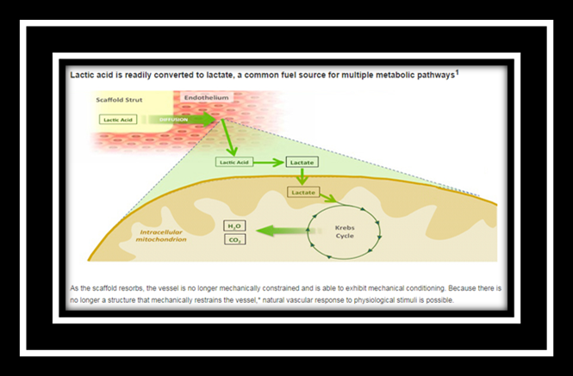
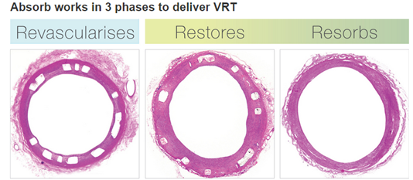
Absorb design elements

Slide 41
ABSORB Cohort A TRIAL
First in man, prospective, open label, single arm study
AIM: To provide data on the feasibility of Bioresorbable vascular scaffold (Abbott BVS) concept, as well as early indications of the benefits of restoration and resorption with a low incidence of late clinical events through 5 years of follow-up (including an absence of scaffold thrombosis)
ABSORB Cohort A recruited 30 patients at 4 sites in Europe and New Zealand undergoing elective PCI for a single, de novo coronary lesion of reference diameter 3 mm
Follow-up schedule: 5 yrs
Adapted from Serruys PW, ACC 2009.

Slide 42
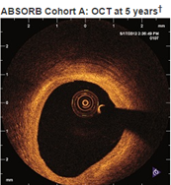
Hence, The ABSORB Cohort A trial provided data on the feasibility of the bioresorbable vascular scaffold concept, as well as early indications of the benefits of restoration and resorption with a low incidence of late clinical events through 5 years of follow-up (including an absence of scaffold thrombosis).

Slide 43
ABSORB Cohort b TRIAL
ABSORB Cohort B recruited 101 patients at 12 sites in Europe, Australia and New Zealand undergoing
elective PCI for up to two de novo coronary lesions in different epicardial vessels with reference vessel
Diameter of 3mm and lesion length ≤ 14mm
Stephan Windecker et al. JACC March 12, 2013,Volume 61, Issue 10

Slide 44
ABSORB Cohort B data also showed the absence of a permanent implant can enable long-term benefits
such as a low incidence of late clinical events. This is demonstrated by 0% scaffold thrombosis at 5 years
in ABSORB Cohort A and 2 years in ABSORB Cohort B

Slide 45
Novel stent coatings strategies

Slide 46
Cd34 antibody
Genous stent (OrbusNeich, Fort Lauderdale, FL, USA), has abluminal coating of CD34 on bare metal stainless steel scaffold
Mechanism: it sequesters circulating endothelial cell progenitors from blood stream thereby improving endothelialization and reducing ST
But this has shown increased rate of vessel occlusion compared to DES at 1st year
Combo Dual Therapy stent (OrbusNeich, Fort Lauderdale, FL, USA), combined CD34 coating with antiproliferative agent, sirolimus and biodegradable polymer coating.
Recently has been approved for use in Europe

Slide 47
Titanium nitric oxide coating
Titan-2 BioActive stentTM (Hexacath, Paris, France): Stainless steel coated in titanium nitric oxide
Nitric oxide donor: vasodilator, platelet inhibitor and inhibit SMC proliferation
Found to be superior to BMS and equivalent to Paclitaxel (TITAX-AMI) and everolimus eluting stents on reducing in-stent late loss

Slide 48
Lipopolyplexes expressing endothelial NO-synthase Dna
Under evaluation
Mechanism: Stent strut is coated with lipopolyplexes expressing nonviral plasmid DNA encoding endothelial nitric oxide synthase, enzyme catalyzing L-arginine→ NO
Hence accelerating endothelialization and inhibiting neointimal hypoplasia

Slide 49
Micromesh covered stent
MGuard sten (InspireMD,Tel Aviv, Israel), designed for acute STEMI
Associate with lower incidence of slow flow or no flow phenomenon
Hoped to be associated with lower rate of incidence of ST at least in early phase

Slide 50
Dedicated bifurcation stents
Designed either for stenting of side branch without missing ostium or for maintaining access to the side branch after main vessel stenting
Provide better stent expansion and lesion coverage without multiple layers of metal within the vessel may reduce the incidence of ST

Slide 51
DAPT: Acc/aha 2011 Guidelines
CLASS I
After PCI, use of aspirin should be continued indefinitely (LOE: A)
Duration of P2Y12 inhibitor therapy after stent implantation should generally be as follows:
a. BMS or DES for PCI for ACS, P2Y12 inhibitor should be given for at least 12 months, Options include clopidogrel 75 mg daily, prasugrel 10 mg daily and ticagrelor 90 mg twice daily (LOE: B)
b. DES for non-ACS indication, clopidogrel 75 mg daily should be given for at least 12 months if the patient is not at high risk of bleeding (LOE: B)
c. BMS for non-ACS indication, clopidogrel should be given for a minimum of 1 month and ideally up to 12 months (unless the patient is at increased risk of bleeding; then it should be given for a minimum of 2 weeks (LOE: B)
Patients should be counseled on the importance of compliance with DAPT and that therapy should not be discontinued before discussion with their cardiologist (LOE: C)
CLASS IIa
After PCI, it is reasonable to use aspirin 81 mg per day in preference to higher maintenance doses (LOE: B)
If the risk of morbidity from bleeding outweighs the anticipated benefit afforded by a recommended duration of P2Y12 inhibitor therapy after stent implantation, earlier discontinuation (e.g. 12 months) of P2Y12 inhibitor therapy is reasonable. (LOE: C)

Slide 52
Dapt: evidences
A prospective observational cohort study, 2002-2004, n=3201, lesion treated: 5389 with DES (SES & PES) with 18 months follow-up
Global incidence of ST of 1.9% within 18 months of
stenting with 72.4% of these events occurring in
first 6 months
Conclusions- Discontinuation of thienopyridine
therapy was the major determinant of ST within
the first 6 months
Flavio Airoldi et al Circulation. 2007;116:745-754

Slide 53
OPTIMIZE: A Prospective, Randomized Trial of 3 Months Versus 12 Months of DAPT with the Endeavor Zotarolimus-Eluting Stent
AIM: To investigate the safety and clinical impact of short-term (3 months) DAPT with Endeavor-ZES in daily clinical practice.

Slide 54
Conclusion: Consistent with other recent studies on shorter DAPT durations, this trial showed that 2nd generation DES might not always require 12 months DAPT to reduce the risk of adverse thrombotic events. These outcomes may be especially relevant for patients who are at high risk of bleeding complications following PCI, such as the elderly and patients with a history of hemorrhagic events, who might need to stop DAPT earlier.

Slide 55
Triton-timi 38
AIM: To compare the efficacy and safety of PRASUGREL and CLOPIDOGREL in patients with at least one stent as part of the index procedure with respect to: Stent Thrombosis (ARC definitions) Ischemic Events, Bleeding Overall and stratified by stent type received

Slide 57
Management of st
Still no clear consensus, prompt reperfusion is critical particularly if presented with acute STEMI
Re-intervention (emergency PCI) is currently preferred if available.
Various methods includes thrombus aspiration, balloon angioplasty, re-stenting with 2nd or 3rd generation stent or even CABG
Additional stent placement should be avoided unless a mechanical reason for initial thrombotic event is ascertained (e.g. edge dissection, residual untreated disease)
Ancillary drugs should be used including GP IIb/IIIa inhibitors
In absence of mechanical cause, hematological evaluation to exclude hypercoagulable state
Maintenance DAPT is typically escalated (Clopi→Prasu/Ticagrelor or Cilostazole may be added)
Fibrinolysis may be used if PCI is unavailable, especially in case of early presentation

Slide 58
Contemporary Measures for Prevention of st
No method completely prevent ST however it can be minimize with certain precautions
A. Stent selection & deployment
B. Anti-platelet therapy

Slide 59
Stent selection & deployment
Selection of 2nd & 3rd generation stents. Polymer free stents is upcoming option
Optimise the stent deployment, if necessary with use of IVUS or OCT
Minimize the overlapping zone
Dissection and strut fracture should be looked routinely after procedure
Use of GP IIb/IIIa inhibitors and bivalirudin, if necessary

Slide 60
Anti-platelet therapy
DAPT should be continued for atleast 12 months if not contraindicated. Xience V & Xience Prime EES have been approved for use with 3 months DAPT in Europe
Prasugrel or Ticagrelor are preferable, if not contraindicated
It is safer to avoid elective surgeries for 12 months after DES implantation.
Emergency surgeries should be done under Aspirin cover.

Slide 61
Future directions
Stents with novel coating agents (CD34 antibody, agents augmenting NO) are under evaluation
Newer drugs like Otomixoban & Cangrelor

Slide 62
Points to remember
Optimum stent sizing and deployment should always be the aimed for during angioplasty
Use of prasugrel or ticagrelor reduce the incidence of ST
It may be preferable to use BMS in patients who are invariably going to undergo any surgery in the 1st year after stenting. The problem of higher rates of ISR should be considered before decision making
Complex angioplasty is the predictor for ST and these patients should be monitored
Use of GP IIb/IIIa inhibitors or bivalirudin may reduce the incidence of ST especially in setting of ACS

Slide 63
THE STRUGGLE CONTINUE …
THANKS

Slide 64
Mcq’s
Risk of late/ very late ST is highest in
BMS
1st generation DES
2nd generation DES
3rd generation DES

Slide 65
2. All are true about Bioresorbable coronary scaffold except:
Facilitate vasomotor function of vessel
Incompatible with CT evaluation of coronary anatomy
Facilitate late luminal enlargement and reduction of scaffold thrombosis
Decrease requirement of DAPT thereby

Slide 66
3. Most common mechanism for early ST:
Residual dissection
Stent under expansion or malapposition
Persistent thrombus
Slow flow

Slide 67
4. Individual contribution for ST is highest for:
Diabetes Mellitus
Bifurcation lesion
Type C lesion
Discontinuation of DAPT

Slide 68
5. Lowest risk of ST among newer generation DES is for
Platinum-Cr EES
Co- Cr EES
Zotarolimus slow release DES
Zotarolimus fast release DES

Slide 69
6. In Triton-TIMI-38 trial, risk of ST decreased in PRASUGREL compare to CLOPIDOGREL by
25%
33%
52%
62%

Slide 70
7. According to ARC definition, early ST means, ST occurring
≤ 24 hrs of PCI
2nd day to 30 days of PCI
1 months to 1 yr after PCI
Both A & B

Slide 71
8. According to ARC definition, all are true for probable ST except
Unexplained death < 30 days
Target vessel AMI within 30 days without angiographic confirmation of thrombosis
Target vessel AMI within 30 days with angiographic confirmation of thrombosis
Both A & B

Slide 72
9. CYP2C19*2 genotype accounts for clopidogrel resistance in
0-5% of cases
10-12% of cases
20-25% of cases
25-30% of cases

Slide 73
10. True about management of ST are all except
Prompt reperfusion is critical particularly if presented with acute STEMI
Fibrinolysis may be used if PCI is unavailable, especially in case of early presentation
Emergency PCI is currently preferred with an additional stent placement in all cases
Maintenance DAPT is typically escalated

Slide 74
answers
Risk of late/ very late ST is highest in
BMS
1st generation DES
2nd generation DES
3rd generation DES

Slide 75
2. All are true about Bioresorbable coronary scaffold except:
Facilitate vasomotor function of vessel
Incompatible with CT evaluation of coronary anatomy
Facilitate late luminal enlargement and reduction of scaffold thrombosis
Decrease requirement of DAPT thereby

Slide 76
3. Most common mechanism for early ST:
Residual dissection
Stent under expansion or malapposition
Persistent thrombus
Slow flow

Slide 77
4. Individual contribution for ST is highest for:
Diabetes Mellitus
Bifurcation lesion
Type C lesion
Discontinuation of DAPT

Slide 78
5. Lowest risk of ST among newer generation DES is for
Platinum-Cr EES
Co- Cr EES
Zotarolimus slow release DES
Zotarolimus fast release DES

Slide 79
6. In Triton-TIMI-38 trial, risk of ST decreased in PRASUGREL compare to CLOPIDOGREL by
25%
33%
52%
62%

Slide 80
7. According to ARC definition, early ST means, ST occurring
≤ 24 hrs of PCI
2nd day to 30 days of PCI
1 months to 1 yr after PCI
Both A & B

Slide 81
8. According to ARC definition, all are true for probable ST except
Unexplained death < 30 days
Target vessel AMI within 30 days without angiographic confirmation of thrombosis
Target vessel AMI within 30 days with angiographic confirmation of thrombosis
Both A & B

Slide 82
9. CYP2C19*2 genotype accounts for clopidogrel resistance in
0-5% of cases
10-12% of cases
20-25% of cases
25-30% of cases

Slide 83
10. True about management of ST are all except
Prompt reperfusion is critical particularly if presented with acute STEMI
Fibrinolysis may be used if PCI is unavailable, especially in case of early presentation
Emergency PCI is currently preferred with an additional stent placement in all cases
Maintenance DAPT is typically escalated

